Slide 1
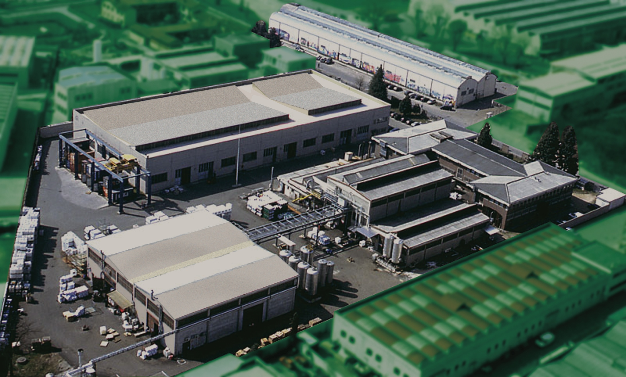
MARBO ITALIA SPA
Chemical Specialties for Industry
The Global presence of Marbo in the Industries

Slide 2
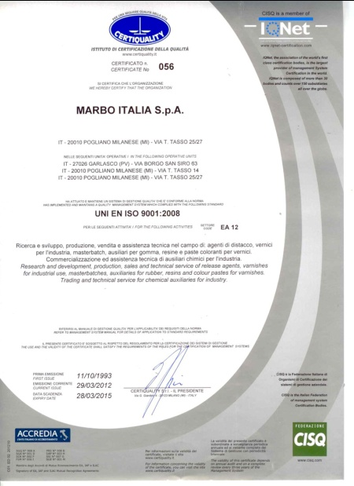
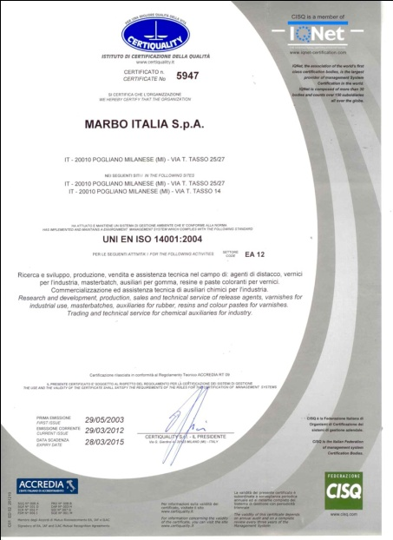
CERTIFICATION
The national and international legislations are kept under control by Marbo and by all the technical and laboratory staff.
Safety and Environment are continuously monitored.
Since 1992 Marbo is Certified UNI EN ISO 9001:2008 and UNI EN ISO 14001:2004.

Slide 3
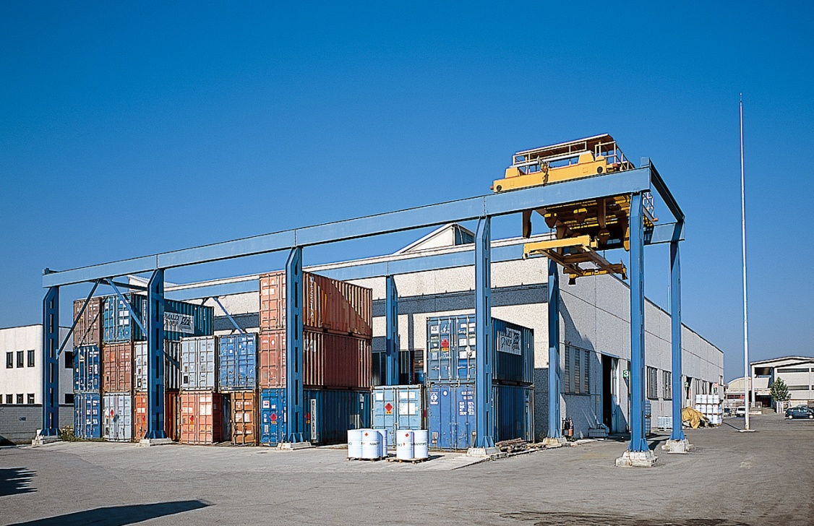
COMPANY FIGURES:Italian sites
HEADQUARTER: POGLIANO MILANESE
Turnover 2011: 32 million Euro
Production: 11.000 tonnes per year
Employees: 57
Manufacturing site: 26.000 m²
Stock facilities: 6.500 m²
Export: over 65%
Investment in new technologies and research: 4% of the turnover per year

Slide 4
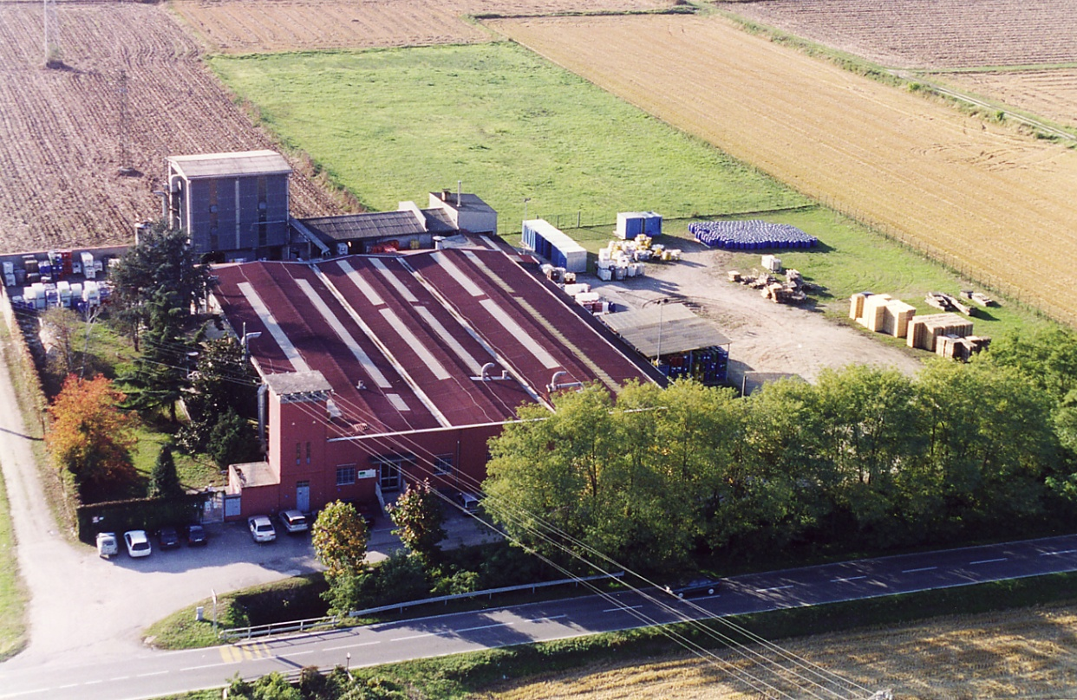
COMPANY FIGURES
GARLASCO SITE
Located in Garlasco (Pavia )
Production: 2.000 Tonnes
Employees: 12
Manufacturing site: 10.000 m²
Stock Facilities: 2.500 m²

Slide 5
MILESTONES.1
1966: Marbo Italia Spa was established by two persons to produce release agents for Polyurethane and lubricants for the Die-casting;
Mission : Development of technologically advanced products;
1986: Acquisition of Mapol, a Company specialized in the research and production of lacquers for PU and for High Vaccum Metalization;
1987: Marbo Italia start the Division of release agents for the Rubber Industry gaining a leading within a short period;
1988: Thanks to a collaboration with UMIST (University of Manchester Institute of Science and Technology), Marbo develop the technology of the Semi-Permanent release agents for Composite High Tech, achieving the approval of the largest aircraft manufacturers;

Slide 6
MILESTONES.2
1992: Start-up of the production of pigment dispersions for Polyurethane to complete the range of products for PU;
2001: Set up of the Joint Venture MARBOCOTE Ltd in Manchester UK, for the development and production of Water Based Semi-Permanent release agents for Rubber and Composite, becoming the only European manufacturer;
2002: Acquisition of the pigment dispersion business and the production site (Garlasco) from Rohm & Haas Italia;
2004 : Set up a subsidiary in U.S.A;
2007: Acquisition of our biggest Italian competitors LEVENIT;

Slide 7
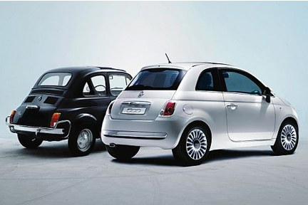
PRODUCTS.1
A FULL PACKAGE OF PRODUCTS FOR THE AUTOMOTIVE INDUSTRY
Release agents for any Polyurethane technology
Release agents and lacquers for Tyres and Rubber
Release agents and Lubricants for Aluminium die casting
Pigmented Paste for Polyurethane Industry
Varnishes for High Vacuum Metallization and Plastics
Pigmented Paste for Polyurethane
Release agents for headliners, acoustic
felts and friction materials

Slide 8
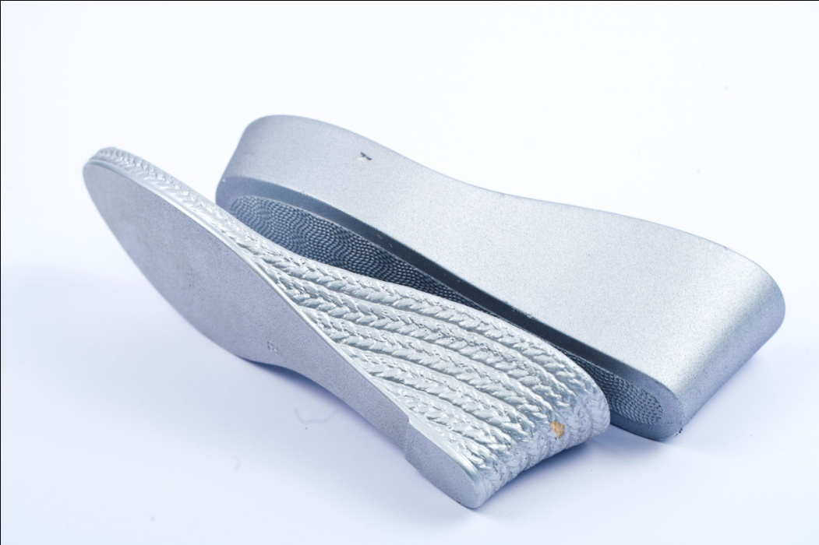
PRODUCTS.2
A FULL PACKAGE OF PRODUCTS FOR THE SHOE-SOLES INDUSTRY
Release Agents for: polyether and polyester polyurethane foams single and dual density, EVA and TR;
Lacquers for polyurethane, EVA, PVC and TR;
Colour paste for polyurethane
Products for leather
Antistatic agents
UV stabilizer for Polyurethane

Slide 9
BUSINESS AREAS
Our products vs main applications :
Polyurethane
Shoe soles
Flexible foam, and acoustic systems
Integral Skin, Rim, Microcellular
Elastomers
Composite
GRP
Advanced Composite
Pultrusion
Metals
Alluminum and Magnesium
Hot Forging
Copper Drawing
Rubber
Tyres
Compounds
Hoses
Belts
Technical Articles
Shoe soles
Plastic
Packaging for Cosmetics
Toys
Roto Moulding
Slash moulding
High vacuum metallization
Footwer

Slide 10
RELEASE AGENTS FOR POLYURETHANE SOLE PRODUCTION Complete range of products for unit soles, mid soles and direct injected soles, single and dual-density, both polyether and polyester. The product range includes: UNIT SOLES - MID SOLES - SINGLE DENSITY DIRECT INJECTION Series LR Ready to use products with high concentration of solvents Series CPD High solid products with low concentration of solvents Series CPD Concentrated products solvents free Series WR Water based high solid products DUAL DENSITY DIRECT INJECTION Series BC Ready to use products with high concentration of solvents Series BCC High solid products with low concentration of solvents APPLICATION AND DOSAGE Ready to use products about 15 – 30 gr./pair - manually with Airless gun High solid products about 2 – 4 gr./pair - with automatic Airmix gun Concentrated products about 1 gr./pair - with automatic Airmix gun

Slide 11
COULOURING PASTES FOR POLYURETHANE
I – IT series are our range of pigmented pastes.
They have been developed for colouring both Polyether and Polyester Polyurethane compounds, used in the production of shoe soles, integral skin, rigid and slab-stock foams, RIM and elastomers.
They are a concentrated pigment dispersion in plasticizer or in polyol
I – IT can be added directly into the mixing head or into the polyol tank.,
The usage level is between 0,5 % and 5 % ( related to the polyol ), depending on the intensity of the colour required and on foam density.
MAIN CHARACHTERISTICS
Viscosity 500 to 10.000 cps depending on the carrier and
concentration of pigment
Density 900 - 1.500 gr/lt
Humidity < 0,5 %
Particles dimensions less than 15 micron
OH number 0 to 32 depending on carrier

Slide 12
FINISHING LACQUERS
These are the products to finish the moulded soles
Our range includes dipping and spray types.
APPLICATION BY DIPPING
Are used with specific machines and the soles are dipped directly into the bath containing the lacquer.
The consumption of lacquer is about 15-25 gr/pair.
The range includes products giving from shiny to matt finishing and all kind of colours.
APPLICATION BY SPRAY
These are products to be used with spray equipment and the consumption is about 20-40 gr/pair, related to the type of product / application / sole model.
The range includes products giving from shiny to matt finishing and all kind of colours of the following categories
- COVERING PROPERTIES ( based on pigment )
- TRANSPARENT FINISH ( based on soluble dye )
- BRUSH-OFF ( for aged effects)
- SPECIAL EFFECTS such as cork imitation, metallic finishing, velvet imitation, rubber-like touch, anti-slip etc.

Slide 13
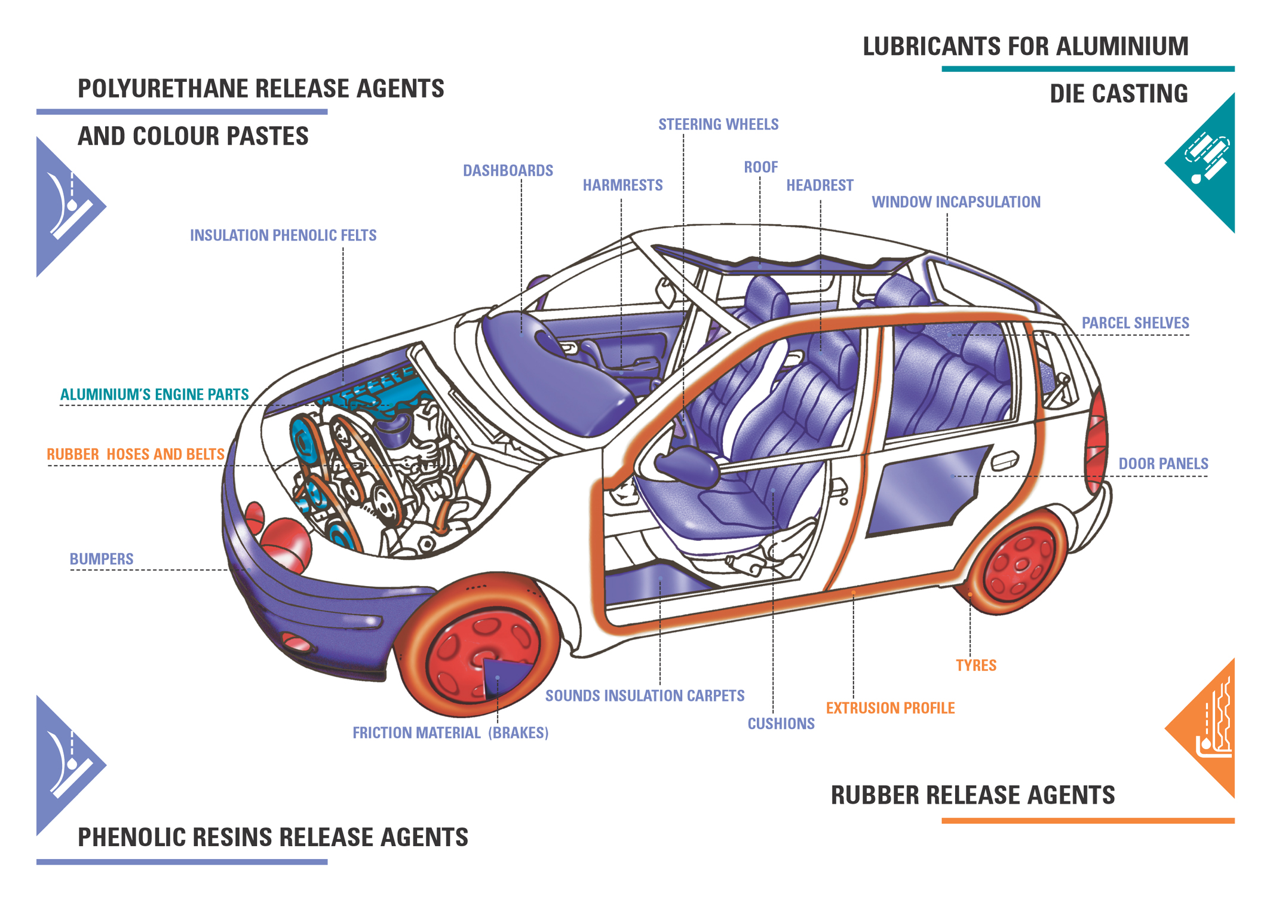
A FULL PACKAGE OF PRODUCT FOR AUTOMOTIVE INDUSTY

Slide 14
RELEASE AGENT FOR FLEXIBLE FOAM
MARBO ITALIA offers for the production of Cold Cure and Hot Cure - MDI, TDI and TDI/MDI formulations,
a complete series of specific release agents and additives for every single application.
The product range includes:
COLD CURE : CUSHIONS AND SOUND INSULATION
Series FF Solvent based r.a. with high release performance, flammable
Series HS High solid release agents in naphtha carriers
Series WR Water based release agents, solvent free
Series Additivo Additive for Anti–Squeak
CR 180 Mould conditioning paste
HOT CURE : CUSHIONS
Series ST…… Concentrated water based release agent
Series Additivo Additive Anti–Squeak
CR 180 Paste for difficult mould areas
The products are formulated to avoid all the possible interference between the release agent and the polyurethane, and ensure that the moulding has a silky smooth surface finish.

Slide 15
RELEASE AGENT FOR ACOUSTIC SYSTEMS
MARBO ITALIA offers for the production of headliners, floors, engine insulation and parcel shelves made with all the technologies – laminates, phenolic felts, and polyurethane - a complete series of specific release agents and additives for every single application.
The product range includes:
LAMINATE TECHNOLOGY
Series TND W Ready to use water based release agents
Series TND CONC Concentrated water based release agents to dilute with water
PHENOLIC FELT TECHNOLOGY
Series TND W Ready to use water based release agents
Series TND CONC Concentrated water based release agent to dilute with water
All the TND products are formulated to allow multiple releases for single application
PU FLEXIBLE TECHNOLOGY
Series FF Ready to use release agents, solvent based
Series HS High solid release agents with ECO carriers
Series WR Water based release agents giving a silky surface finish.

Slide 16
RELEASE AGENT FOR CASTABLE ELASTOMERS
MARBO ITALIA offers for Castable Elastomer technologies, both TDI and MDI prepolymer based system at low or high temperature processing, a complete series of specific release agents.
The product range includes:
SUPERELEASE S Aerosol cans; highly flammable
Series EL 717 Ready to use; flammable or not flammable depending on solvent
CPD INT BO 30 High solid in white spirit carrier, developed for very difficult moulds
CPD 102 CO 30 High solid in white spirit carrier
Serie WR Water based

Slide 17
RELEASE AGENT FOR INTEGRAL SKIN FOAM
MARBO ITALIA offers for Integral Skin foams, used for the production of Steering wheels, Headrests, Armrests, etc. a complete series of specific release agents and products for every single application.
The product range includes:
Series INT Ready to use release agents solvent based
Series CPD INT High solid release agents in isoparaffinic or naphtha carriers
Series WR Water based release agents
Series I – IT Colour pastes
The products are formulated to avoid all the possible interference of the release agent with the polyurethane and allows the production of parts with finishes from high gloss to mat

Slide 18
RELEASE AGENT FOR RIM, R-RIM, S-RIM SYSTEMS
MARBO ITALIA offers for Rim, S-Rim and R-Rim technologies for the production of Internal trim items, a complete series of specific release agents and products for all application.
The product range includes:
Series RIM Ready to use release agents, solvent based
Series CPD RIM High solid release agents in isoparaffinic carrier
Series WR Water based release agents
Series IMR Internal mould release
All the three release agents are washable using hot water systems

Slide 19
WORLD-WIDE NETWORK
More then 65 countries supplied
1 subsidiary: USA
1 JV: UK
40 distributors with local stock
10 agents
MARBO

Slide 20

MARBO GROUP
MARBO ITALIA
phone +39 02 93961.1
fax +39 02 93257172
e-mail contact@gruppomarbo.com
www.gruppomarbo.com
MARBOCOTE Ltd. - UK
phone +44 1606 738737
fax +44 1606 738846
e-mail joanna@marbodocte.co.uk
MARBO AMERICA INC.
phone +1 407-607-1200
fax +1 407-671-1225
e-mail TauChemDST@aol.com

